Slide 1

SIDDARTHA INSTITUTE OF SCIENCE AND TECHNOLOGY (AUTONOMOUS)
Department of Computer Science and Engineering
Title of Project: Blockchain-Based Digital Certificate Generation and Verification System
Presented by
THUPAKULA LEENA SRI 224E1A3357
KASHINACHINNA NARASIMHA REDDY 224E1A3312
NIMMAKAYALA KETHANA 224E1A3349
DWARAKACHARLA GURU PRASANTH REDDY 224E1A3323
KOLLATHURU LAVANYA 224E1A3354
Under the guidance of
DR.R.SANDEEP
Associate Professor
Dept. of CSE

Slide 2
ABSTRACT
Traditional paper-based or centralized digital certificates are prone to forgery, tampering, and delays in verification, which can lead to credibility issues and administrative inefficiencies.
This project proposes a Blockchain-based Digital Certificate Generation and Verification System that leverages the decentralized, immutable, and transparent properties of blockchain technology to securely issue, store, and verify digital certificates.
The system allows educational institutions or organizations to generate certificates in a tamper-proof digital format and store them on a blockchain network, ensuring authenticity and preventing fraud.
Recipients can access, download and share their certificates, while employers or verification authorities can instantly generate and validate the credentials without intermediaries.

Slide 3
INTRODUCTION
Traditional paper-based and centralized digital certificate systems are prone to forgery, tampering, loss, and slow verification, leading to credibility concerns and administrative inefficiencies.
Centralized storage also lacks transparency and is vulnerable to security breaches, making it difficult to guarantee the authenticity of issued credentials.
Blockchain technology provides a secure alternative through its decentralized, immutable, and tamper-resistant structure.
This project proposes a blockchain-based digital certificate generation and verification system that enables institutions to issue certificates in a secure digital format and store them on a distributed ledger, ensuring that records cannot be altered after issuance.
Certificate holders can easily access, download and share their credentials, while employers and verification authorities can generate and verify authenticity instantly without intermediaries. By leveraging smart contracts and cryptographic hashing, the system enhances security , transparency, and trust in the entire certificate lifecycle.

Slide 4
DOMAIN SPECIFICATION
Blockchain Technology
A decentralized and immutable digital ledger system that securely records, stores, and verifies data without relying on a central authority.
Ensures tamper-proof storage of digital certificates through immutable ledger entries.
Eliminates fraudulent modifications by using cryptographic hashing and distributed consensus.
Enables instant and reliable generation and verification of certificates by employers or authorities.
Supports transparent and secure communication between certificate issuers, holders, and verifiers.
Involves:
➢ Distributed Ledger Technology (DLT)
➢ Smart Contracts
➢ Cryptographic Hashing
➢ Decentralized Storage
➢ Peer-to-Peer Verification
➢ Consensus Mechanisms

Slide 5
LITERATURE SURVEY
Sno | Title of the Paper | Year | Authors | Comments
1 | Blockchain for Secure Academic Certificate Verification | 2020 | Choudhary et al. | Proposes using blockchain to eliminate certificate forgery and provides a decentralized verification framework for academic credentials.
2 | Decentralized Digital Credential Issuance Using Blockchain | 2019 | Patel & Mehta | Presents a blockchain-based architecture for issuing tamper-proof digital certificates with an immutable audit trail.
3 | Blockchain-Based Educational Record Authentication System | 2021 | Kumar et al. | Demonstrates how blockchain ensures transparency and immutability in storing academic records, enabling instant third-party verification.
4 | Secure Document Management and Verification Using Smart Contracts | 2018 | Singh & Roy | Explores the use of smart contracts to automate certificate issuance and validation, improving security and reducing administrative overhead.
5 | Blockchain Technology for Preventing Certificate Fraud in Higher Education | 2022 | Al-Harbi & Rahman | Reviews real-world implementations of blockchain-based credentialing systems and highlights their efficiency in preventing forgery and tampering.

Slide 6
PROBLEM STATEMENT
Traditional certificate issuance and verification processes rely on paper documents or centralized digital systems that are vulnerable to forgery, tampering, and data manipulation. These limitations often lead to credibility issues, administrative delays, and difficulty in verifying the authenticity of credentials. Employers and verification authorities must depend on intermediaries, which increases processing time and operational cost. Students and certificate holders also face challenges in securely storing and sharing their documents. The absence of a unified and tamper-proof verification mechanism results in inefficiencies across academic and professional sectors. Therefore, there is a need for a decentralized, secure, and transparent system that ensures reliable certificate generation and instant verification.

Slide 7
Existing System
In the existing system, digital or paper-based certificates are typically issued and managed by individual institutions or organizations using centralized databases. Verification of these certificates requires contacting the issuing authority, which is time-consuming and often involves manual processes. Paper certificates are prone to damage, loss, or forgery, while centralized digital systems are vulnerable to hacking, data manipulation, or unauthorized access. There is no universal or tamper-proof method to instantly validate credentials, causing delays for employers, verification agencies, and certificate holders. Moreover, recipients often face difficulties in securely storing and sharing their certificates online. Overall, the current systems lack transparency, security, and efficiency, making them unreliable for modern academic and professional needs.

Slide 8
DISADVANTAGES OF EXISTING SYSTEM
Paper-based certificates are prone to loss, damage, and forgery.
Centralized digital systems are vulnerable to hacking and data manipulation.
Verification requires contacting the issuing authority, causing delays.
There is no secure, universal method for instant certificate validation.
Recipients face difficulties in safely storing and sharing their credentials.

Slide 9
PROPOSED SYSTEM
The proposed system is a Blockchain-Based Digital Certificate Generation and Verification System that enables secure, tamper-proof issuance and management of digital certificates. Using blockchain technology, certificates are stored on a decentralized and immutable ledger, ensuring authenticity and preventing forgery or unauthorized modifications. Educational institutions or organizations can generate digital certificates and upload them directly to the blockchain, while recipients can securely access, download, and share their credentials. Employers and verification authorities can instantly verify the authenticity of certificates without relying on intermediaries, reducing delays and administrative workload. The system provides transparency, security, and efficiency, addressing the limitations of traditional paper-based and centralized digital systems.

Slide 10
ADVANTAGES OF PROPOSED SYSTEM
Provides tamper-proof and secure storage of digital certificates using blockchain.
Enables instant and reliable verification without intermediaries.
Reduces administrative workload and verification delays.
Allows recipients to easily access, download, and share their credentials.
Ensures transparency, authenticity, and fraud prevention in certificate management.

Slide 11
SYSTEM REQUIREMENTS
Hardware Requirements
Processor: Intel i5/i7 or equivalent
RAM: 8–16 GB (recommended for model training)
Storage: 256 GB SSD or higher
GPU (optional but recommended): NVIDIA GPU for faster LSTM training

Slide 12
SYSTEM REQUIREMENTS
Software Requirements
Operating System: Windows
Python Version: Python 3.8+
Libraries / Frameworks: Flask , Web3.py (for blockchain interaction), PyCryptodome (for encryption)
IDE : PyCharm
Database: MySQL
Blockchain Platform: Hyperledger Fabric

Slide 13
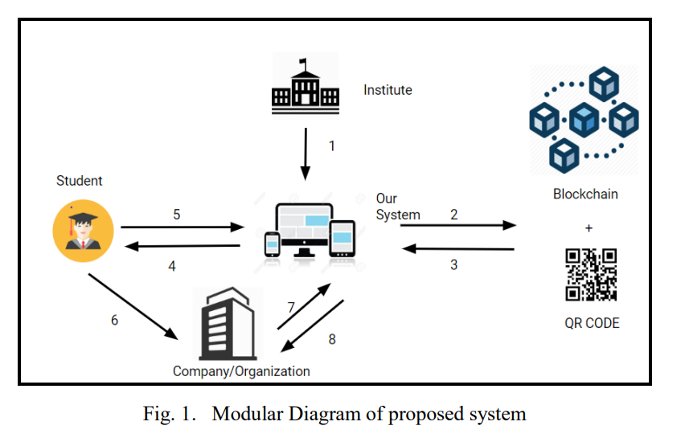
BLOCK DIAGRAM

Slide 14
MODULES
1. User Registration and Authentication Module
Purpose: Allows institutions, students, and verification authorities to securely register and access the system.
Key Functions:
Registers new users with role-based access (admin/institution/recipient/verifier).
Implements secure login using hashed passwords and two-factor authentication (optional).
Maintains user profiles and access privileges.
Significance: Ensures that only authorized users can generate, access, or verify certificates, enhancing system security.

Slide 15
MODULES
2. Certificate Generation Module
Purpose: Enables institutions to create digital certificates in a secure and tamper-proof format.
Key Functions:
Collects certificate details (name, course, grade, issue date, etc.) from institutions.
Generates a digital certificate and converts it into a blockchain-compatible format.
Creates a unique cryptographic hash for each certificate for verification purposes.
Significance: Automates certificate creation and ensures authenticity and integrity of each credential.

Slide 16
MODULES
3. Blockchain Storage Module
Purpose: Stores generated certificates on a decentralized blockchain network.
Key Functions:
Deploys smart contracts to handle certificate storage and management.
Records certificate hashes and metadata on the blockchain ledger.
Ensures immutability and prevents unauthorized modifications.
Significance: Provides a tamper-proof, transparent, and permanent record of all issued certificates.

Slide 17
MODULES
4. Certificate Verification Module
Purpose: Allows employers, verification authorities, or other institutions to validate certificates instantly.
Key Functions:
Accepts certificate hash or QR code from the user.
Checks the blockchain ledger to confirm authenticity and issuance details.
Returns verification status in real-time without contacting the issuing institution.
Significance: Reduces delays, eliminates intermediaries, and ensures trust in the verification process.

Slide 18
ALGORITHMS
1. Hashing Algorithm
The Hashing Algorithm generates a unique fixed-length cryptographic hash for each digital certificate.
It ensures data integrity by producing a hash value that changes if even a single detail of the certificate is modified.
This is fundamental for verifying the authenticity of certificates stored on the blockchain.
2. Public-Key Cryptography Algorithm
The Public-Key Cryptography Algorithm uses a pair of keys (private and public) to secure certificate data.
The issuing institution signs the certificate using a private key, while verifiers use the corresponding public key to confirm authenticity.
This ensures secure, tamper-proof certificate issuance and verification.

Slide 19
ALGORITHMS
3. Smart Contract Algorithm
Smart Contracts are self-executing code deployed on the blockchain to automate certificate management.
They handle certificate issuance, storage, and verification without intermediaries, enforcing rules automatically.
This guarantees transparency, immutability, and reduces administrative overhead.
4. SHA-256 Algorithm
The SHA-256 Algorithm generates a unique 256-bit cryptographic hash for each digital certificate.
It converts certificate details into a fixed-length hash that changes completely if any data is modified.
Recipients, employers, or verification authorities can use the hash to instantly verify the authenticity of certificates stored on the blockchain.
This ensures data integrity, prevents tampering, and provides a secure, tamper-proof method for certificate verification.

Slide 20
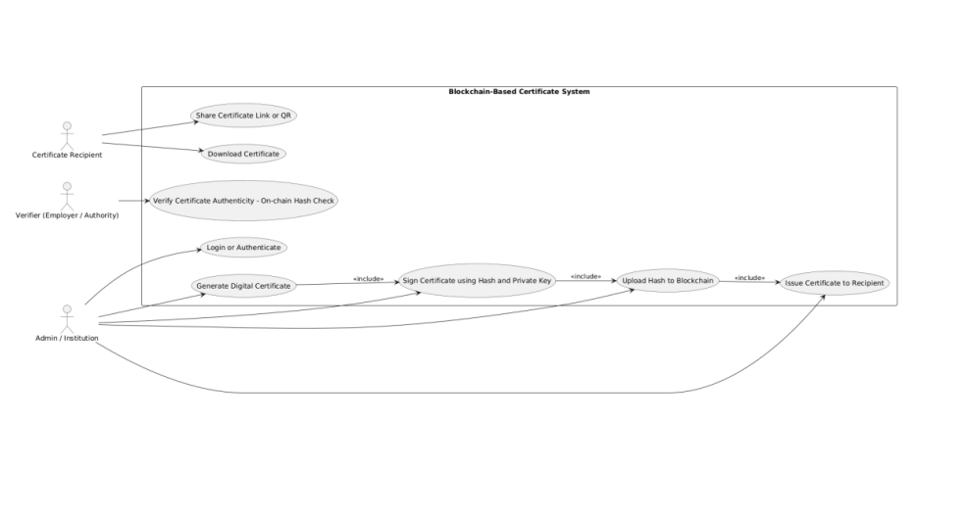
UML DIAGRAMS
Use Case Diagram

Slide 21
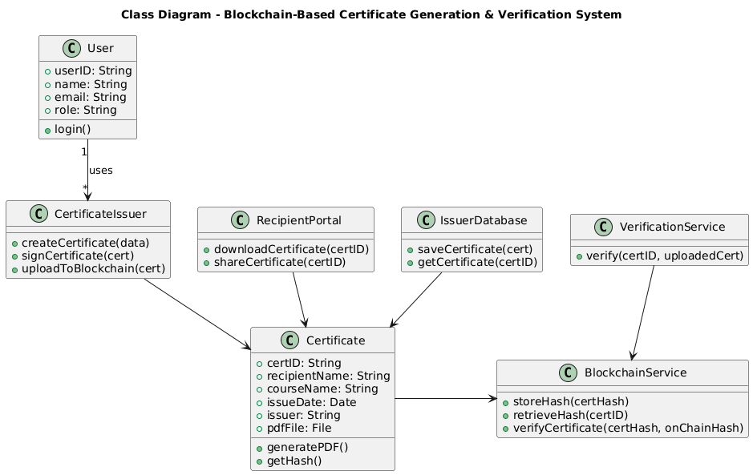
UML DIAGRAMS
Class Diagram

Slide 22
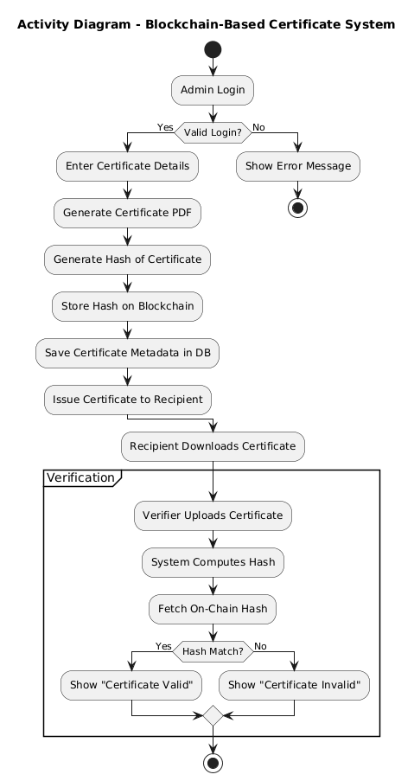
UML DIAGRAMS
Activity Diagram

Slide 23
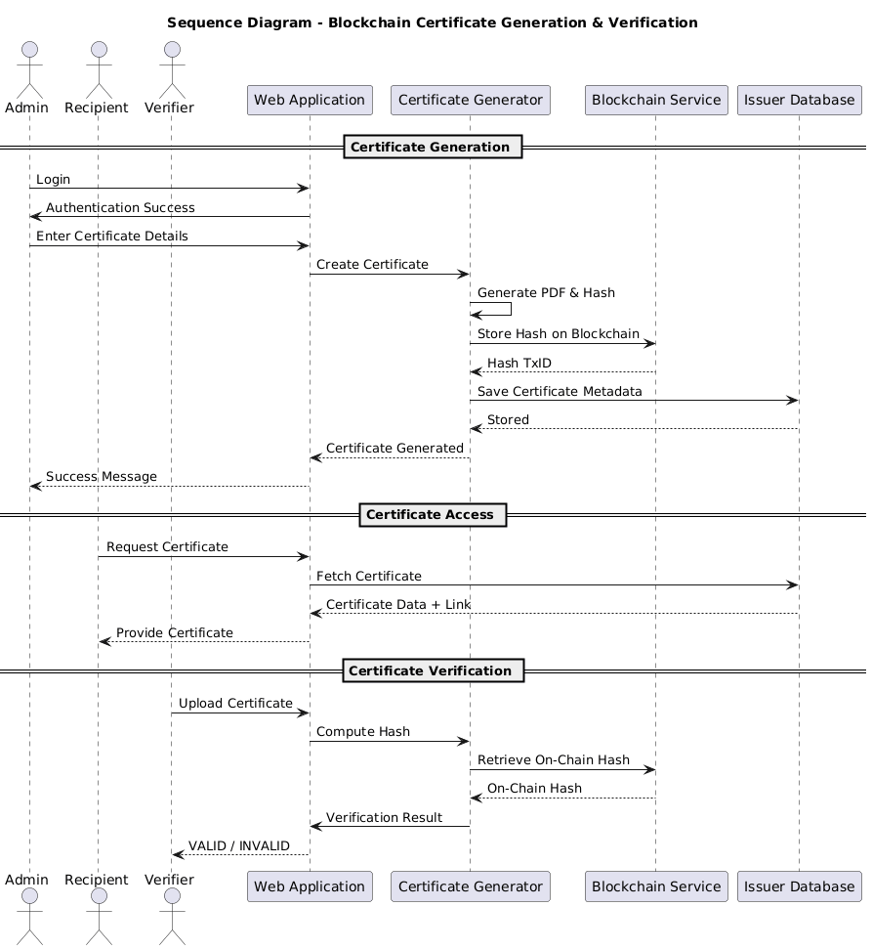
UML DIAGRAMS
Sequence Diagram

Slide 24
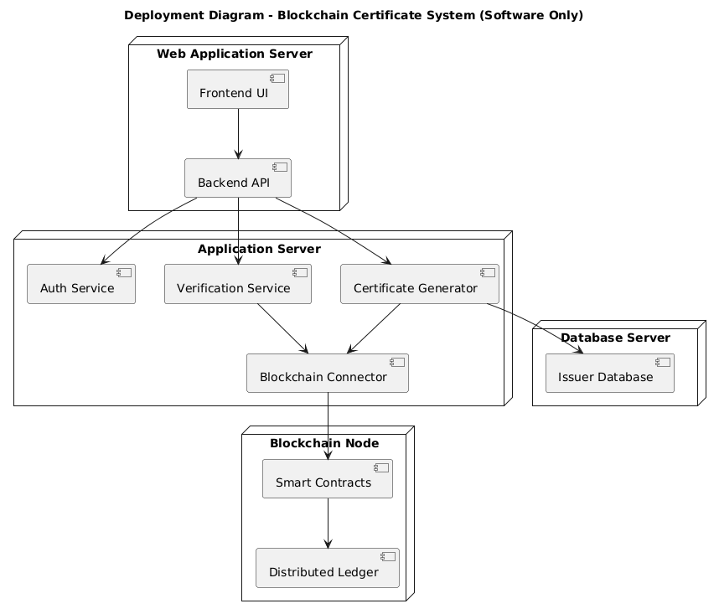
UML DIAGRAMS
Deployment Diagram

Slide 25
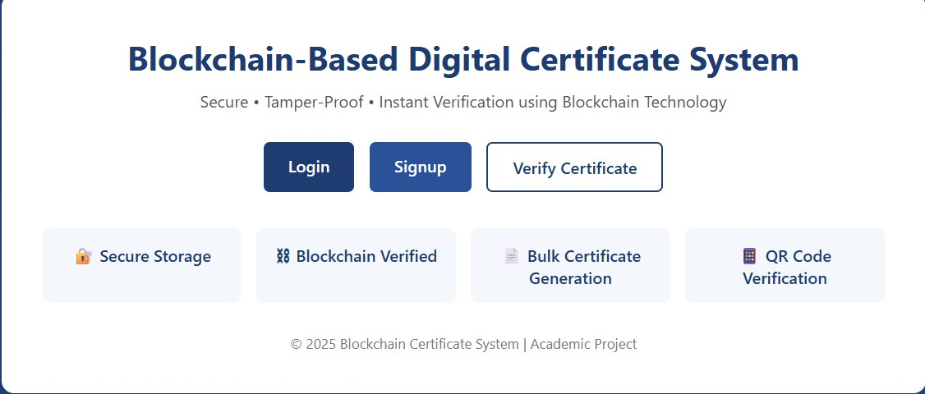
RESULT

Slide 26
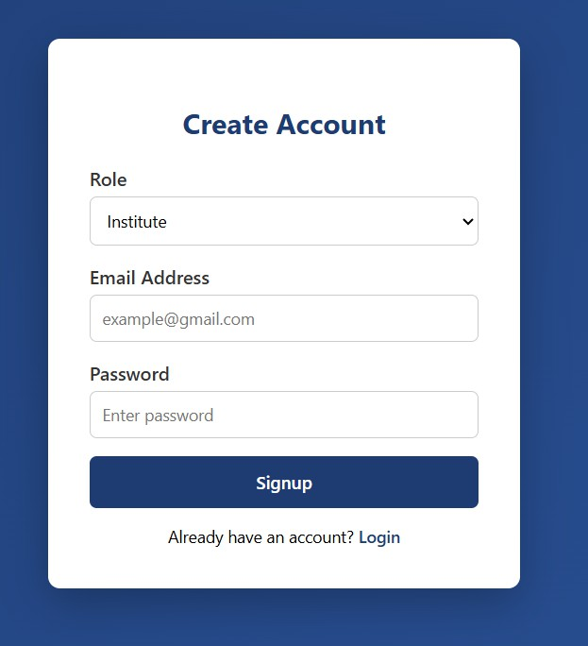
RESULT

Slide 27
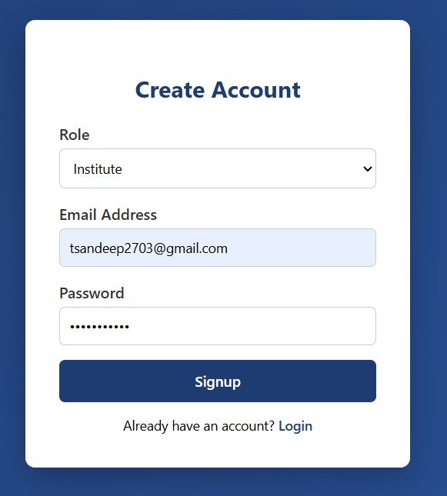
RESULT

Slide 28
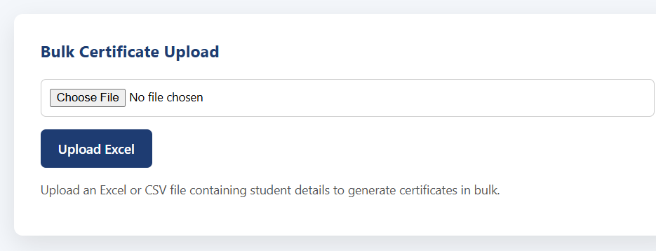
RESULT

Slide 29
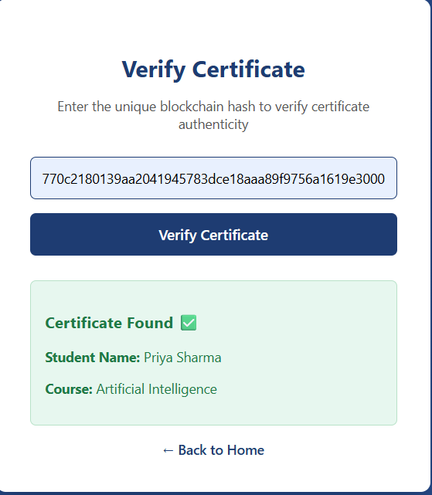
RESULT

Slide 30
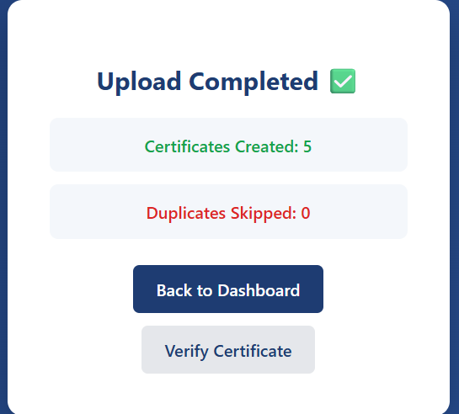
RESULT

Slide 31
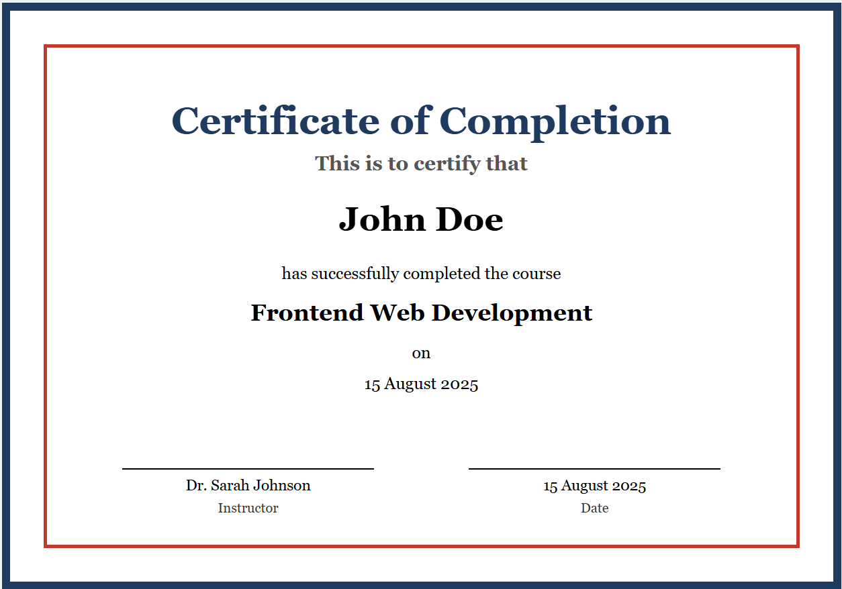
RESULT

Slide 32
CONCLUSION
The Blockchain-Based Digital Certificate Generation and Verification System provides a secure, efficient, and tamper-proof solution for issuing and verifying academic certificates. By leveraging blockchain technology, cryptographic hashing, and QR-based verification, the system eliminates certificate forgery and reduces verification delays. The system is scalable, user-friendly, and suitable for educational institutions and organizations seeking secure digital certification solutions.

Slide 33
Future Enhancement
Integration with Smart Contracts Smart contracts can be enhanced to automate certificate issuance, revocation, and expiration based on predefined rules, reducing manual intervention.
Interoperability Across Blockchains The system can be extended to support multiple blockchain platforms, enabling cross-institution and cross-network certificate verification.
Biometric-Based Identity Verification Adding biometric authentication (fingerprint or facial recognition) can further strengthen the identity verification of certificate holders.
Scalability and Performance Optimization Implementing layer-2 solutions or sidechains can improve transaction speed and reduce costs for large-scale certificate issuance.
Mobile Application Support Developing a secure mobile app would allow users to easily access, share, and verify certificates anytime using QR codes or blockchain links.

Slide 34


